Slide 1

TESCO
BUSINESS INTELLIGENCE

Slide 2
List of contents
TESCO
Overview of case and Organisation
Problem Identification
Clear Ideas Framework
VISA Appraisal
Recommendation
Conclusion

Slide 3
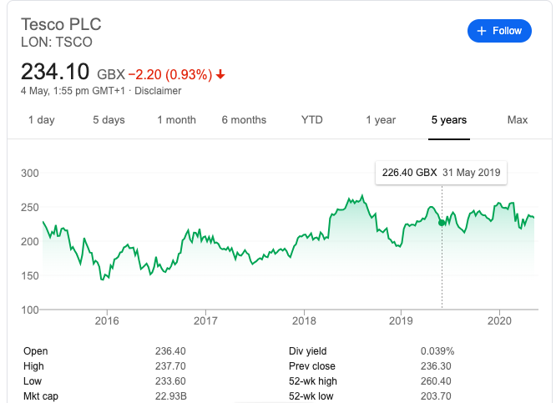
Overview of case and Organisation
Tesco plc, trading as Tesco, is a British multinational groceries and general merchandise retailer with headquarters in Hertfordshire, England, United Kingdom.
It is the third-largest retailer in the world measured by gross revenues and the ninth-largest retailer in the world measured by revenues.
It has shops across Asia and Europe and has more than 6500 + shops

Slide 4
Overview of case and Organisation

Slide 5
Text

Slide 6
Text

Slide 7
Text

Slide 8
Text

